Slide 1
Chapter 17
CSE 3442
Tom Rethard

Slide 2
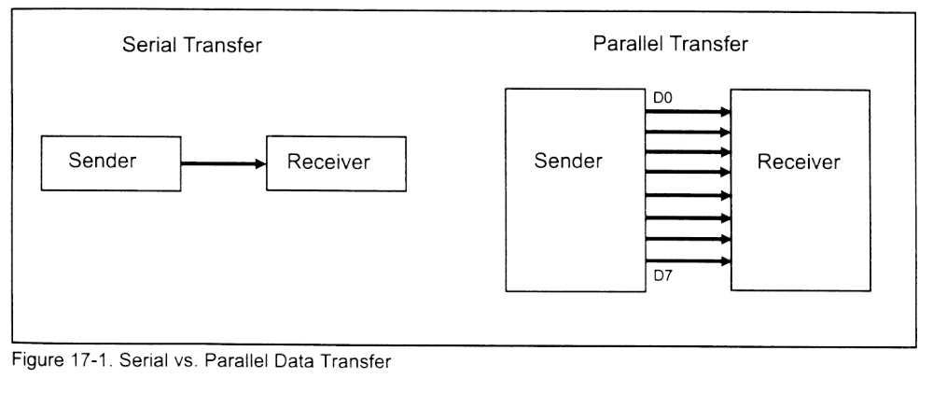
Serial vs. Parallel

Slide 3
Serial vs. Parallel
Serial
  Slower
  Longer distance
  Bit stream
Parallel
  Faster
  More limited distance
  Byte stream

Slide 4
Serial I/O
Requires parallel-to-serial and serial-to-parallel conversion
Use parallel-in-serial-out register at transmitting end
Use serial-in-parallel-out register at receiving end

Slide 5
MODEM
MODulator/dEModulator
Converts bit stream to analog (sinosoidal signals)
Relatively limited speed

Slide 6
Serial Communication
Synchronous
  Transfers a block of characters at a time
Asynchronous
  Transfers a byte at a time
Typically use chips instead of writing code
  UART – Universal Asynchronous Receiver-Transmitter
  Also, USART – Universal Synchronous-Asynchronous Receiver-Transmitter

Slide 7
“Duplex”
Simplex Transmission
  Can only send data
Duplex Transmission
  Can transmit and receive data
  Full Duplex
    Send and receive at same time
  Half Duplex
    Send or receive at any one time

Slide 8
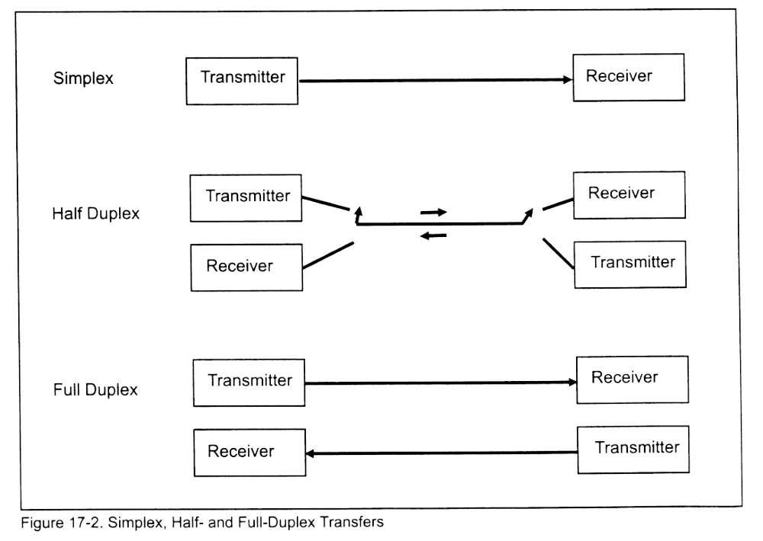
Transfer Types

Slide 9
Asynch and Framing
Communication requires a protocol
  “over”, “out”, etc.
  Determines how data is packaged
    Bits per character
    Beginning and ending of transmission, etc.

Slide 10
Asynch Protocol
Start and Stop Bits
  Each character surrounded by start and stop bits
  These form the “frame”
  Start bit is always low
  Stop bit(s) is always (are) high (1 most common)
  Mark – line is high
  Space – line is low
Data characters
  5-8 bits wide

Slide 11
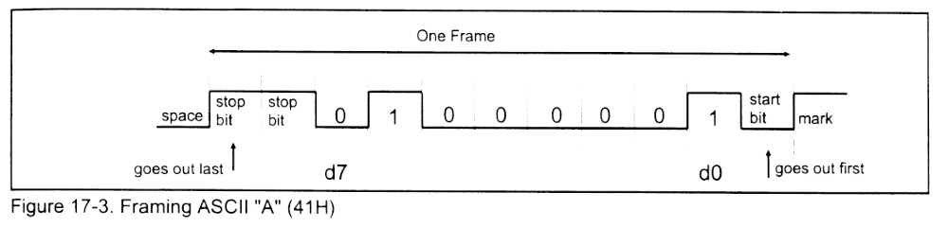
Framing

Slide 12
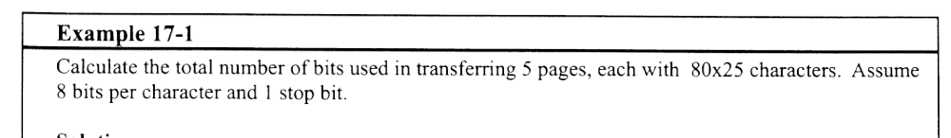
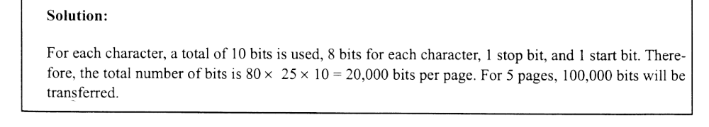
Example 17-1

Slide 13
Parity
Some systems include a parity bit with each character
May be odd or even parity
Transmitted after MSB, before Stop

Slide 14
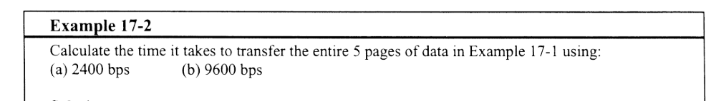
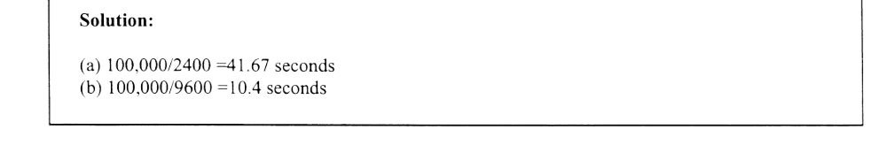
Example 17-2

Slide 15
Data Transfer Rates
Measures in bps
  Bits Per Second, or baud
However, bps <> baud rate!
  Baud rate is modem term for number of signal changes per second
  One signal change may transmit multiple bits
For practical purposes, bps = baud rate

Slide 16
Transfer Rates
Originally 100-9600 bps
Increased to 19,200 bps
Now can get considerably higher
  115,000 bps or higher on newer machines

Slide 17
RS-232
Set by EIA (Electronics Industries Association in 1960
  Modified to RS-232A in 1963
  RS-232B in 1965
  RS-232C in 1969
Most widely used serial I/O interface standard

Slide 18
RS-232C
+3 to +25 V is 0
-3 to –25 V is 1
-3 to +3V is undefined
Not exactly the +5V we’ve been working with!
  Use Motorola MC1488 and MC 1489 line drivers to attach RS-232C to UARTS

Slide 19
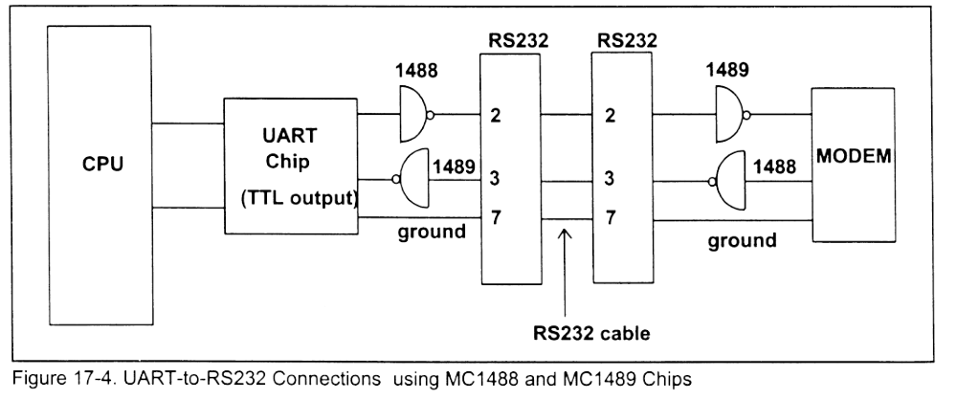
UART-to-RS232 Connections

Slide 20
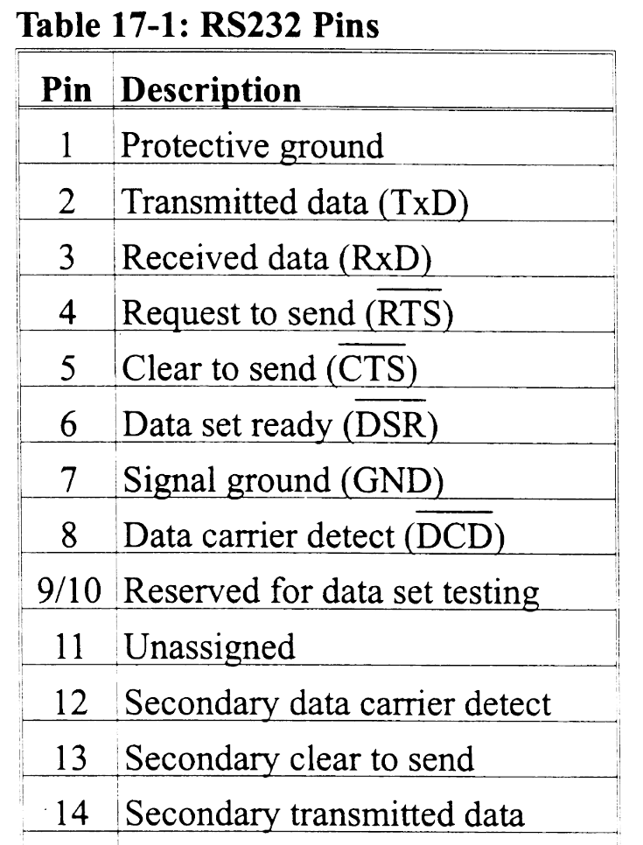
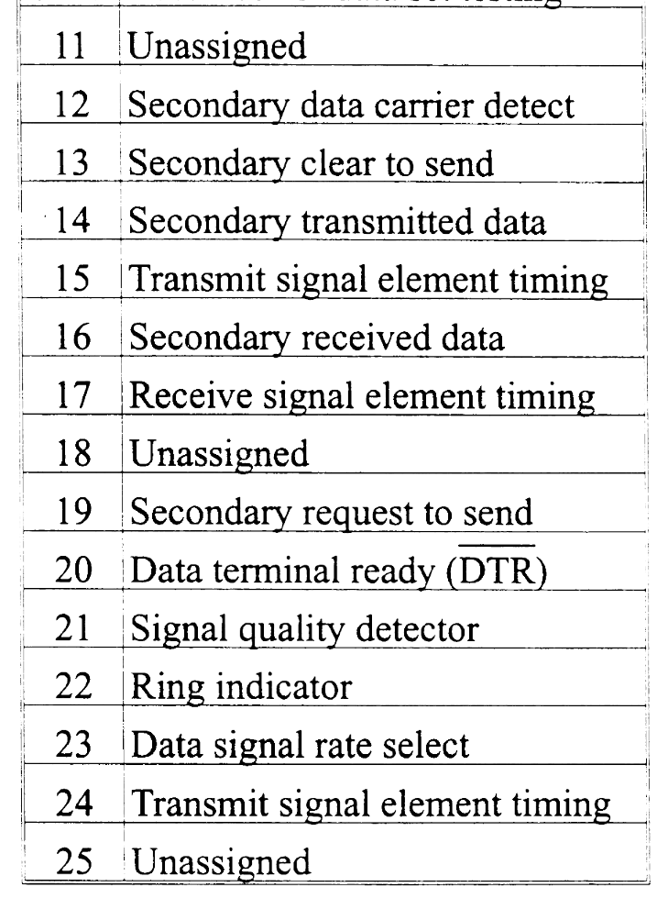
RS-232 Pins

Slide 21
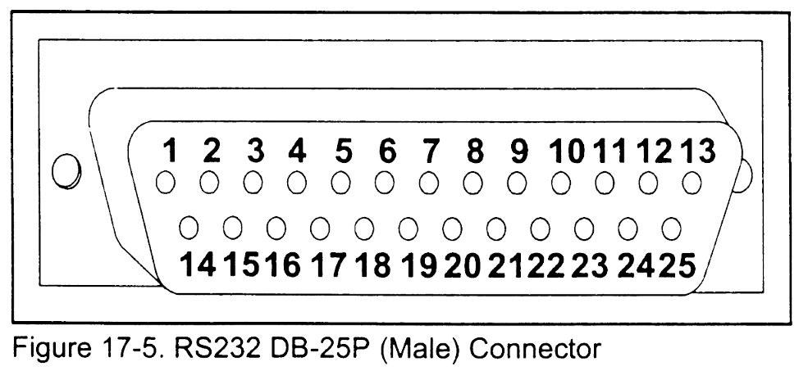
DB24 RS232C Connector

Slide 22
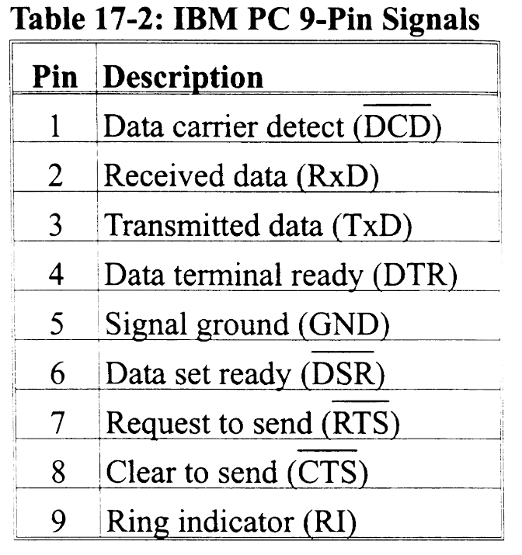
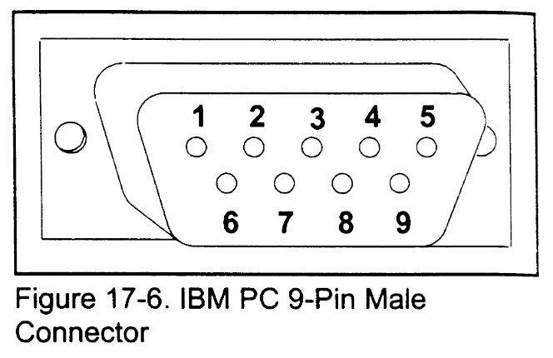
IBM PC 9 Pin Connector

Slide 23
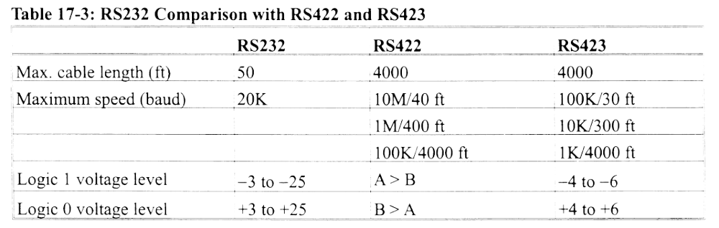
RS-232 vs. 422 vs. 423

Slide 24
DTE and DCE
DTE
  Data Terminal Equipment
  Terminals and computers that send and receive data
DCE
  Data Communication Equipment
  Communications equipment, such as modems, responsible for transfer of data

Slide 25
DTE-DCE Connections
DTE-DCE Simplest connection is 3 wires
  TxD
  RxD
  Ground
DTE-DTE simplest connection
  Same, but swap pins 2 & 3

Slide 26
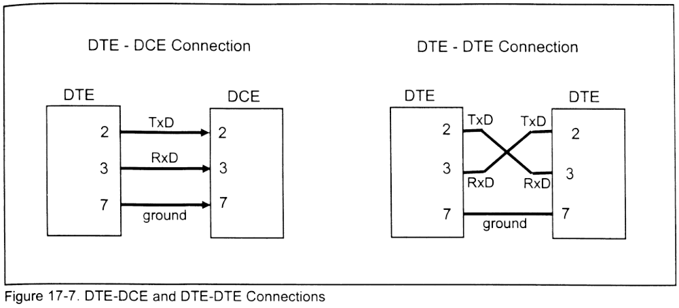
DTE vs. DCE

